Slide 1



Insights into the metatranscriptome and metabolome of the vaginal microbiome
Tromso 2016
Greg Gloor
Dep’t of Biochemistry
University of Western Ontario

Slide 2
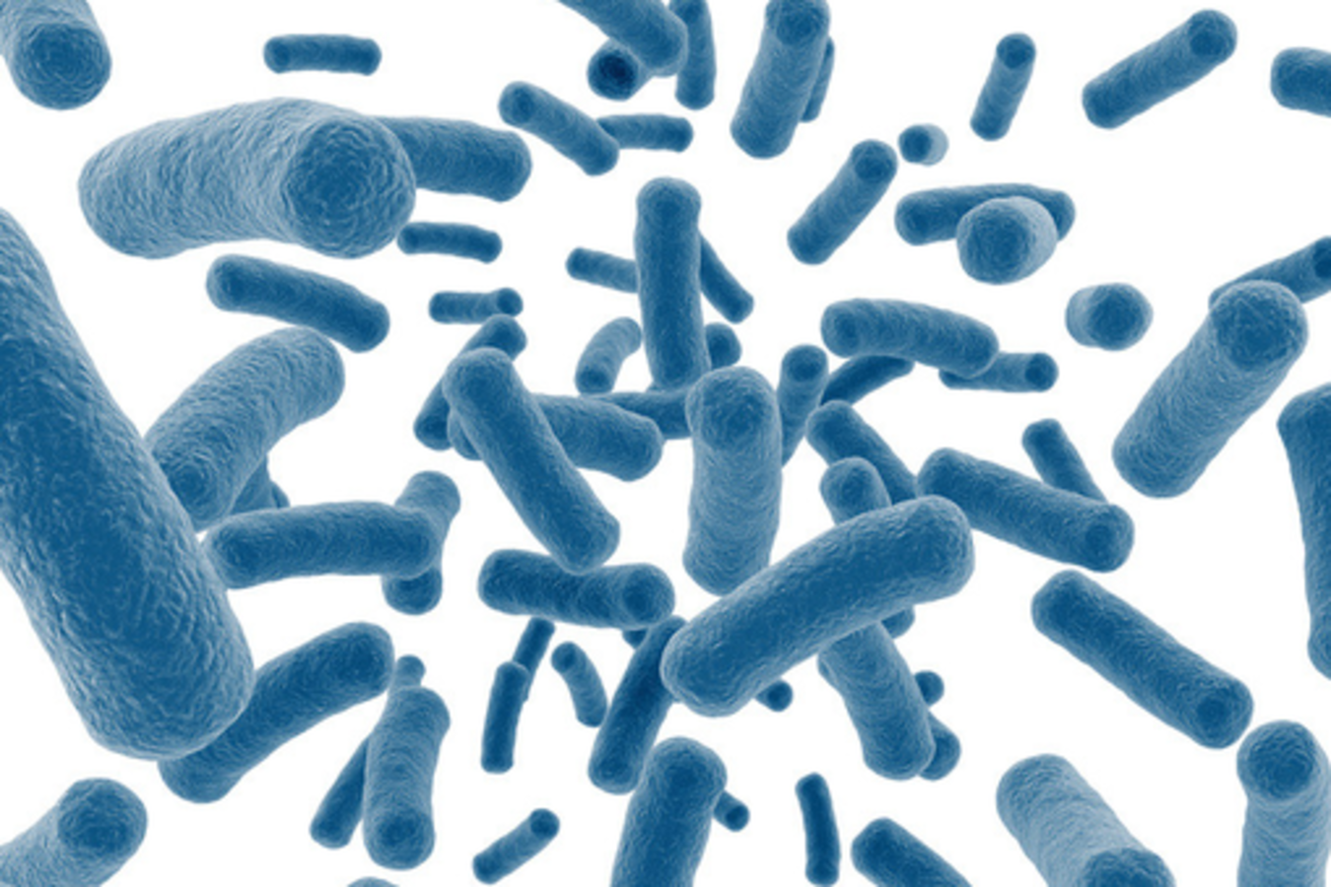
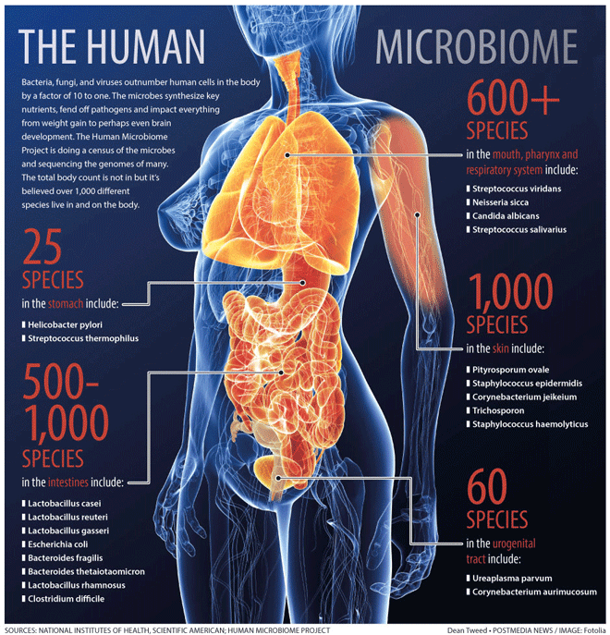
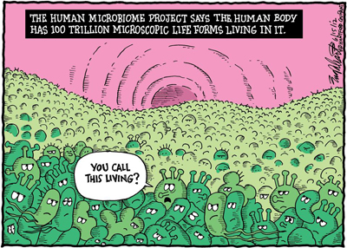
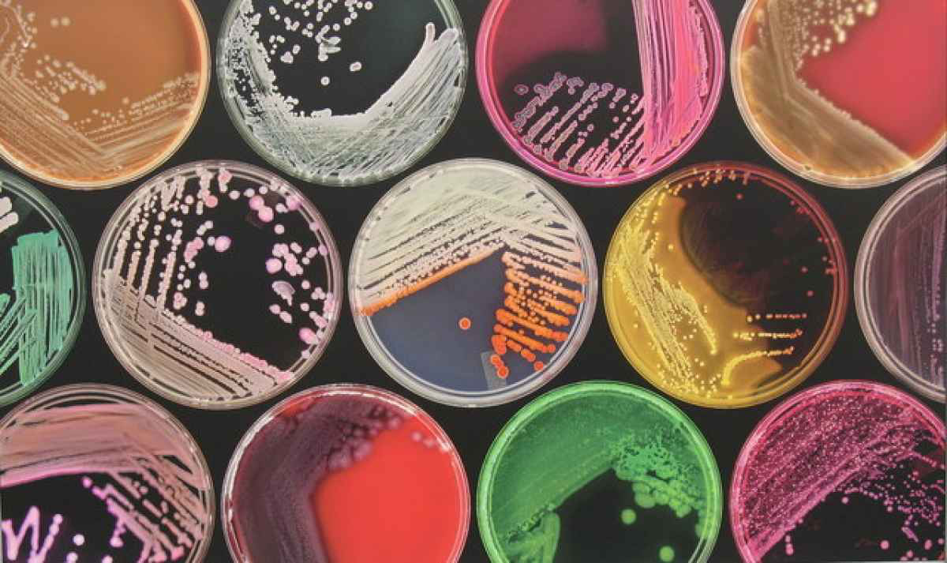
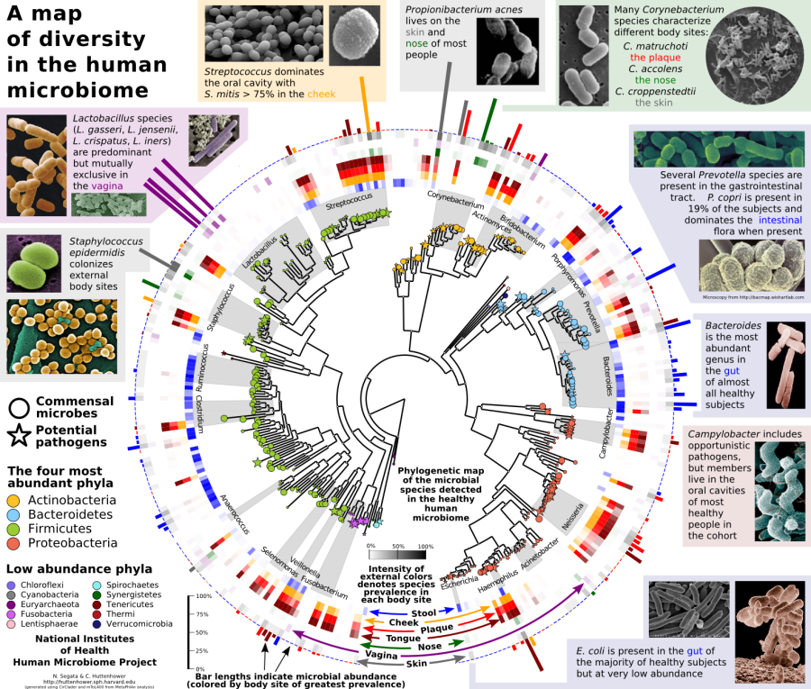
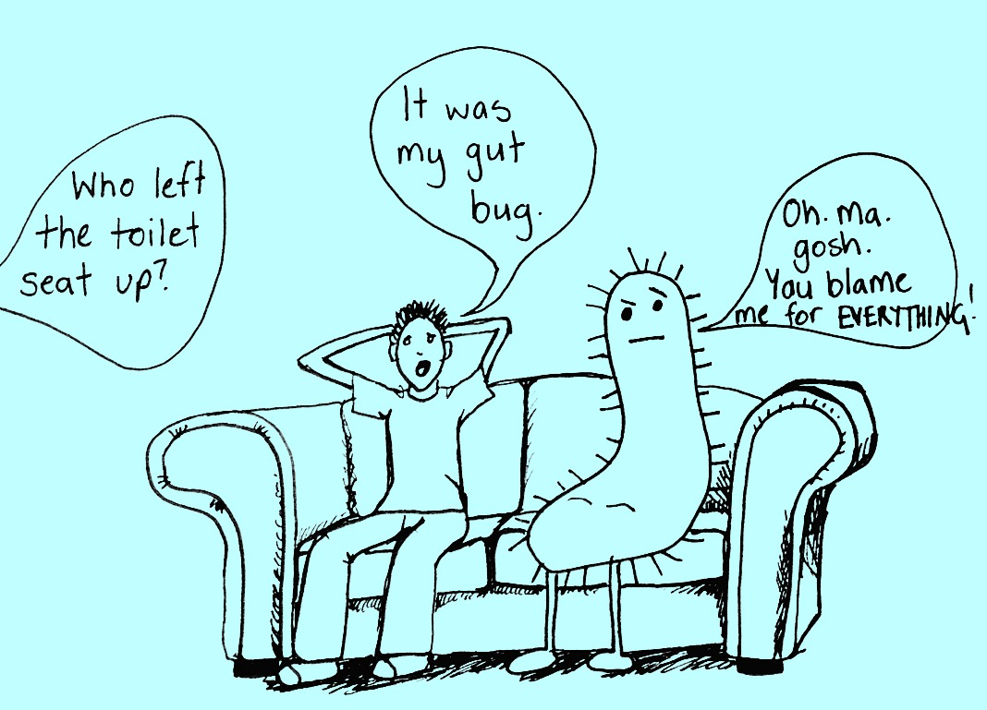
The microbiome

Slide 3
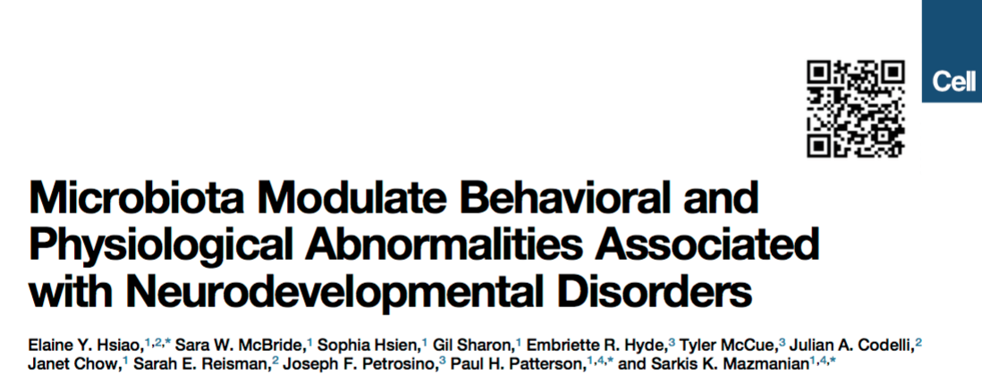
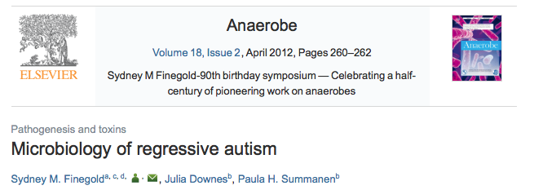
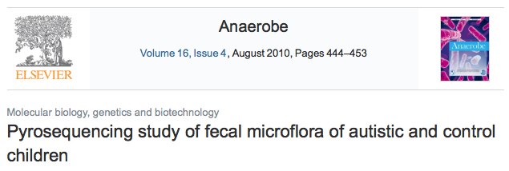

The search for the magic bacterium
Reduced Bacteriodes fragilis
Excess Desulfovibrio
Reduced Bifidobacterium
Excess Bacteriodes

Slide 4
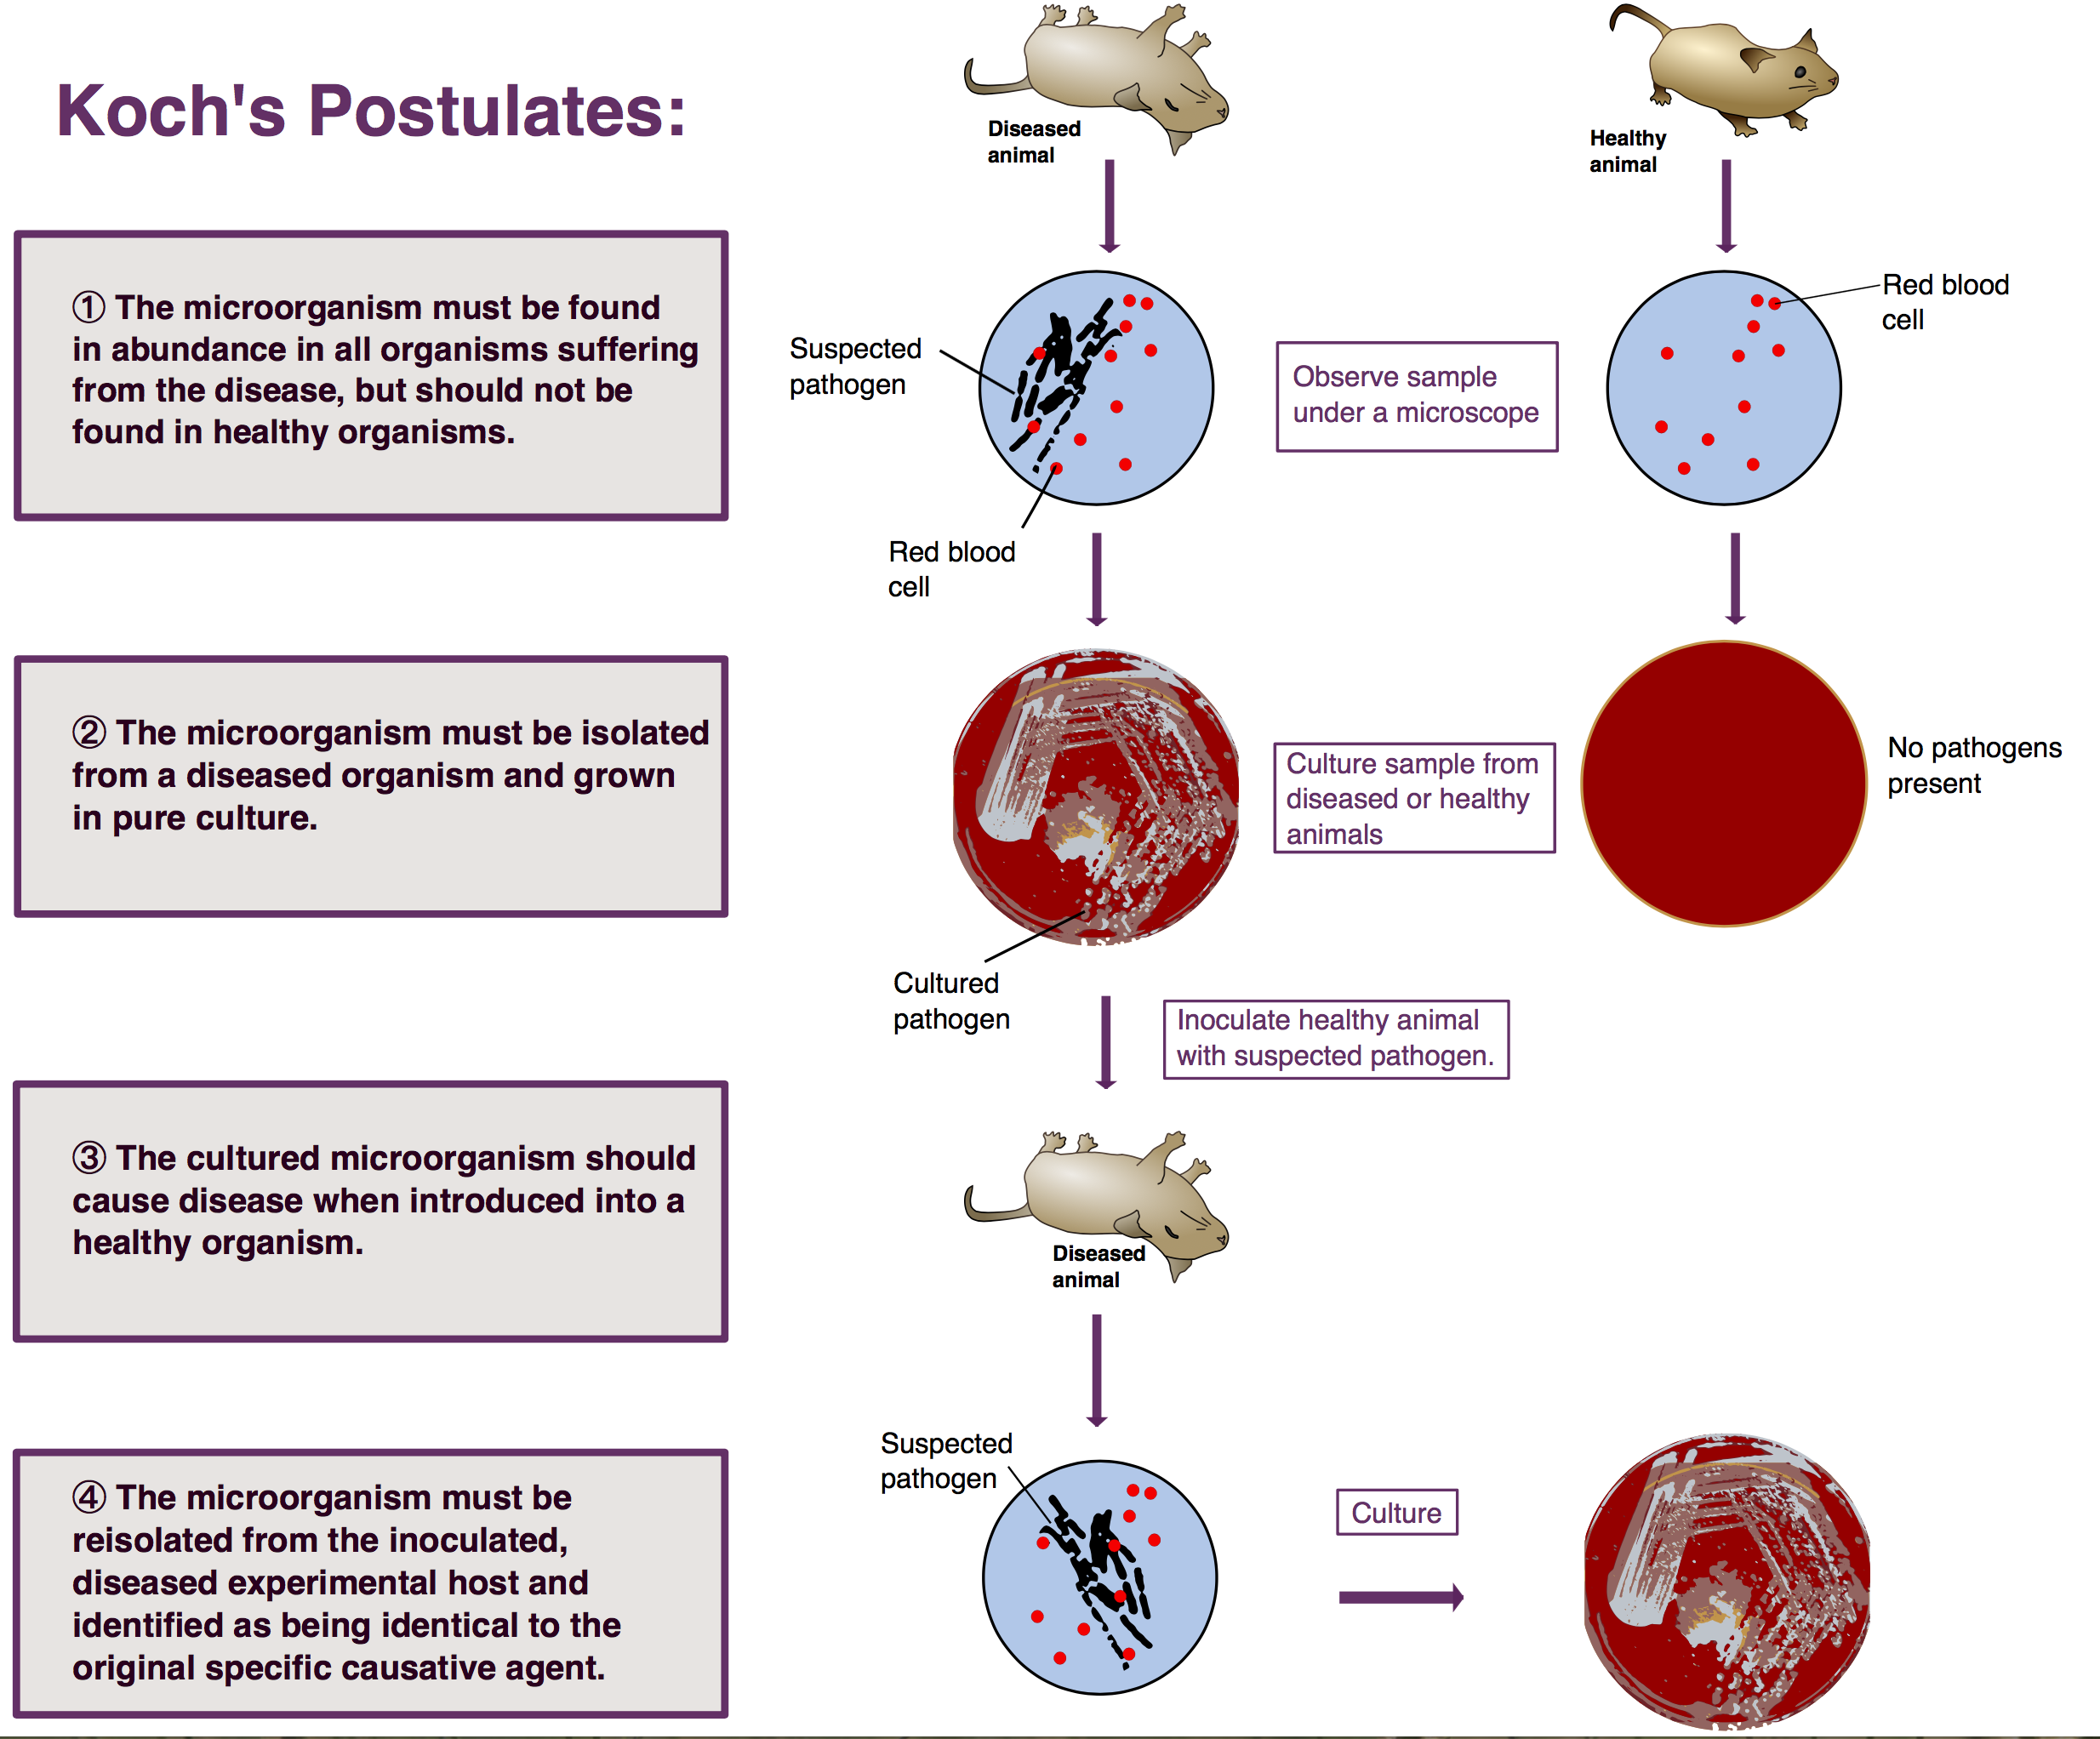
Koch’s postulates

Slide 5
Koch’s postulates
Necessary
and
Sufficient

Slide 6
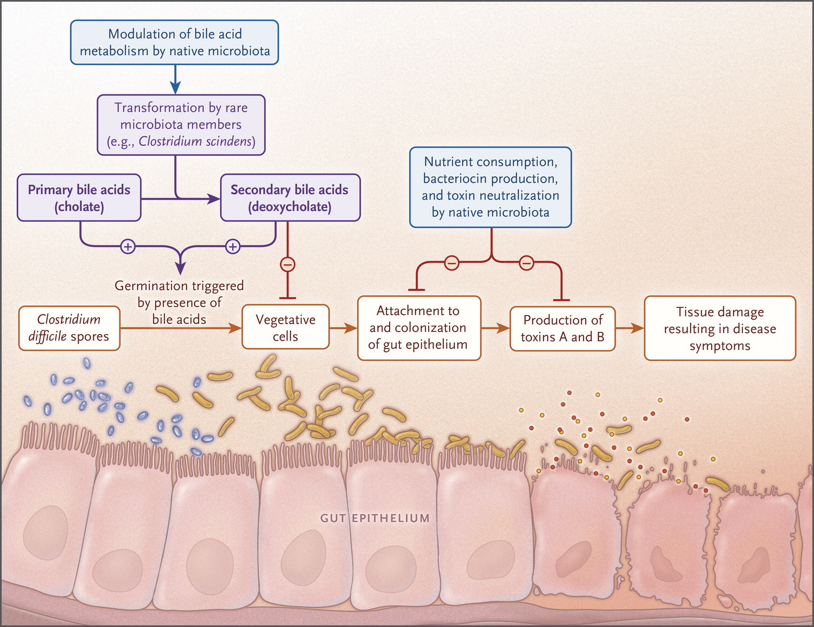
Clostridia difficile infection
C. difficile is found in ~5% of population
Transmitted by fecal-oral route
Toxins glucosyltransferase
A,B: target rho-GTPase
Diarrhea, cramping, overgrowth
Risk factors include fluoroquinalone, cephalosporin, clindamycin prescription, acid-suppression medication, hospital or long-term care
Rupnik M. N Engl J Med 2015;372:1566-1568.

Slide 7
Koch’s postulates
C. difficile
No
Yes
Maybe
Yes

Slide 8
Koch’s postulates
C. difficile
No
Yes
Maybe
Yes
Necessary
but not
Sufficient

Slide 9

Clostridia difficile treatment
More antibiotics
Metronidazole, vancomycin, fidoxamicin
Probiotics
Stool transplant
Surgery!

Slide 10
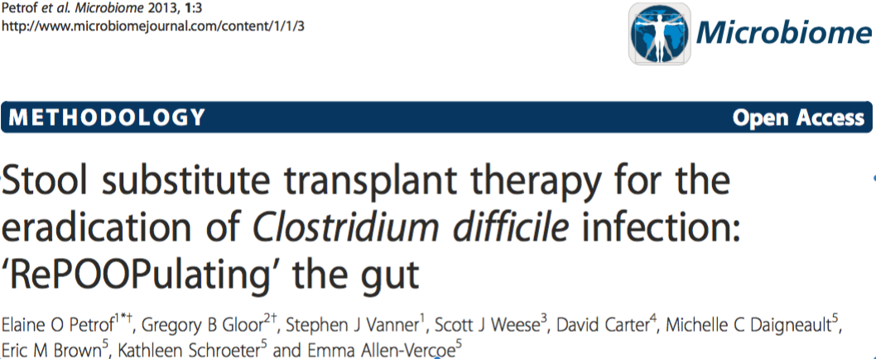
It’s the ecosystem

Slide 11
It’s the ecosystem

Slide 12
It’s the ecosystem

Slide 13
Bacterial vaginosis
Overgrowth of mixed anaerobic bacteria
Not inflammatory
Not infection
Common reason for physician visit
Signs
Discharge
Odor
irritation
Associated with
Increased risk of pre-term birth
Increase risk of STD, including HIV
Increased risk of PID

Slide 14
Microbial profile of BV
Loss of Lactobacillus sp.
Gain of anaerobic bacteria

Slide 15
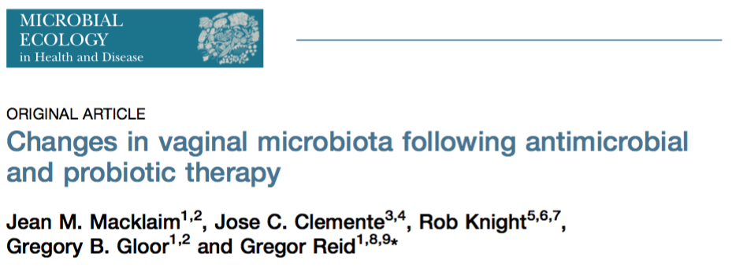
The magic bacterium in BV?
62 women with BV in two treatment arms
Standard therapy: tinidazole + placebo
Probiotic therapy: tinidazole + L. rhamnosus GR1, L. reuteri RC14

Slide 16
The magic bacterium in BV?
Hypothesis
GR1, RC14 would colonize
62 women with BV in two treatment arms
Standard therapy: tinidazole + placebo
Probiotic therapy: tinidazole + L. rhamnosus GR1, L. reuteri RC14

Slide 17
The ecosystem changes with BV treatment

Slide 18
The ecosystem changes with BV treatment
Effect is indirect

Slide 19
It’s the ecosystem
One organism is rarely the cause, or the cure
C. difficile can be a model citizen or a brat (Necessary)
One Lactobacillus sp. can modulate something to allow other species to re-colonize in the vagina (Sufficient)
So we must start to look at the entire ecosystem as a unit
What are the organisms doing?
How are they interacting with the host?

Slide 20
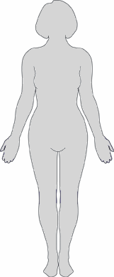
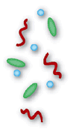
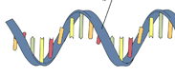
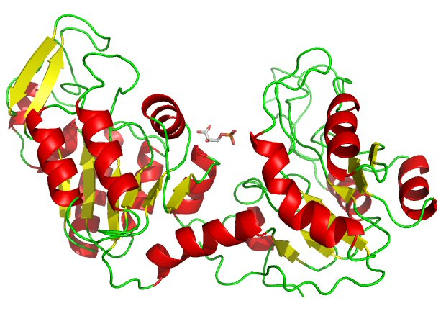
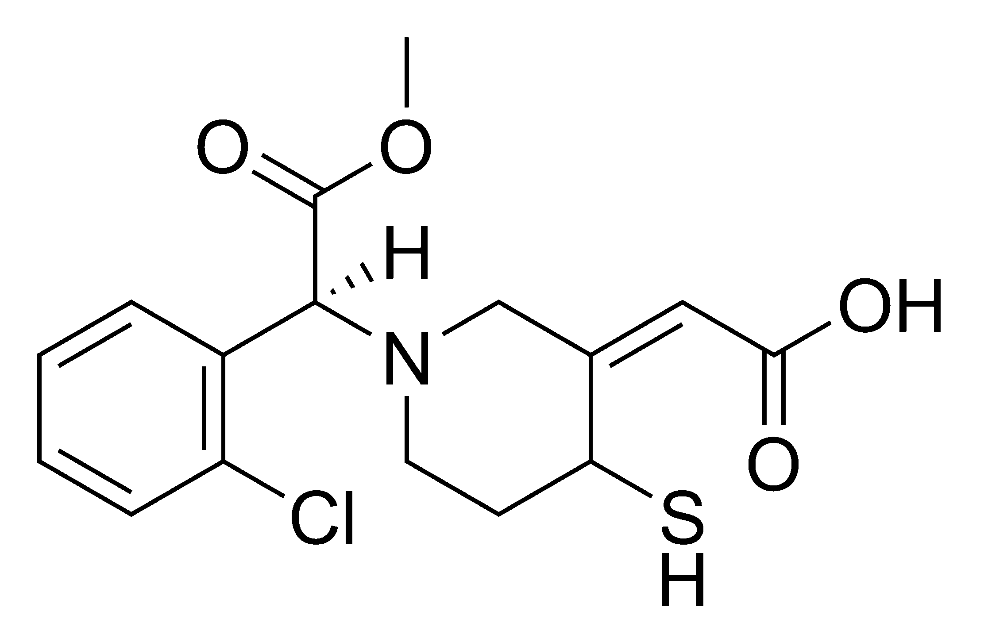


The role of microbes and the “meta-organism”
Jean Macklaim
Microbiome
Targeted amplicon seq (e.g. 16S)
High-throughput sequencing
Metagenomics
Metatranscriptomics
Proteomics
Metabolomics
DNA
mRNA
Proteins
Metabolites
Notes:
So there’s no doubt that microbes influence their environment
A major challenge of any microbiome investigation is to determine the role of the microbes in the environment, and the effects on the host or system
In terms of human health, there are many open questions of what (if any) role our resident microbiomes have on disease progression or maintenance of health, etc.
Different “levels” of using “high-throughput omics” to probe the microbiome
And these different levels seek to address: Who’s there, what are they capable of, what are they doing, what are they producing

Slide 21
High-throughput sequencing (HTS): the problem begins
Compositional (parts of a whole)
Treating compositional data as non-compositional puts you at risk for problems
Spurious correlations
Misleading results
Notes:
Of course, a lot of these ’omics technologies use high-throughput sequencing to generate data
From a population of molecules (RNA, DNA, or targeted amplicons), we make a library, and then a relatively small sample of those molecules are sequenced
We then use some kind of binning or mapping to generate a counts table of reads per feature
The problem that many people don’t consider is that these data are compositional
MEANING the ONLY information from data are the relationships between the parts and Not the count values themselves
Treating compositional data as non-compositional puts you at risk for problems: spurious correlations, misleading results

Slide 22
HTS in microbiome = more problems
High-throughput sequencing data are compositional
Variability*
Sparsity* (presence of zero values)
* Changing presence and abundance of organisms (and therefore gene populations)
Notes:
As I’ve mentioned, Not only are the data compositional, but there are 2 other major problems studying microbiomes: variability and sparsity (or number of zeros in the data)
Most of These both can be attributed mainly to the changing presence and abundance of different taxa in the community

Slide 23
The sample set (16S)
Healthy
Bacterial Vaginosis (BV)
Notes:
Here’s as example to show you what I mean
This is the 16S rRNA gene sequencing output of the human vaginal microbiome. Each bar is a sample and each color is a taxonomic member of the community
Under typical healthy conditions is it a low diversity community with each sample dominated by one species of these blue Lactobacilli
A dysbiotic shift can happen where there is a drastic change to a high-diversity community called bacterial vaginosis (BV) on the right. You can hopefully see they are quite different communities
Click: Some organisms change abundance, like Lactobacillus iners
Click: Some organisms present in one condition are almost entirely absent in another like Atopobium

Slide 24
Metatranscriptomics (ie. meta-RNAseq)
Bacterial mRNAseq reads
Reference genome CDS
Assembly of novel ORFs
90% sequence ID clustering: refseqs
Organism-specific
Read mapping
Group by SEED subsys4
Function
Notes:
This is a very distilled down workflow for how we generated the data
There are a few steps before, but we get to a point where we have enriched bacterial mRNA reads
We then do two things:
1. Collect putative coding sequences from reference genomes
Assemble de-novo and predict open reading frames (ORFs)
The sequences are clusters into 90% sequences identity refseqs that we map to
From these we retain the organism or taxonomic information
But we also take those refseqs and group them functionally using the SEED subsystem database

Slide 25
RNAseq data analysis by CoDa
RNAseq tools do not work well in microbiome data
Cannot account for the very large variance
Predictions based on changes in read abundance (not compositional)
CoDa
ALDEx2
* Part II
+
Centre-log-ratio (CLR) transformed
Log of ratio of feature abundance relative to the geometric mean abundance of all features per sample
Zero replacement
CZM (exploratory) or Monte-Carlo Dirichlet estimate (quantitative) with pseudo-count
Notes:
As I mentioned, my interest is finding the functional contribution of the taxa to this condition. I will be showing you an example of CoDa applied to a microbial meta-transcriptome
When we started analyzing these data we came across two major problems with current analysis tools in microbial RNAseq
1. The first is they could not account for the large variance and sparsity. In FACT the tools explicitly work under the premise that most genes or features are not changing – NOT TRUE! In microbiome
2. The predictions were based off changes in read abundance which is not in the compositional framework
So we developed tools and a framework for compositional data analysis, or CoDa
And these are all things being pioneered by my supervisor, Greg Gloor who gave a talk this morning about how CoDa works
In brief, to convert read count data to compositional data, you do a centre-log ratio, or CLR, transformation
We then get the ratio of the feature abundance relative to a geometric mean which we use as a measure of transcript expression
Of course since we are doing a log transformation, we apply a zero-replacement method
A important note about zeros: A zero is not always a zero!
You just haven’t sampled enough
Zeros are also due to differential presence: e.g. complex microbial communities where the presence of organisms can change
-----------------------------
Zeros are uncertain (a zero doesn’t mean zero) so the Dirichlet allows us to estimate better what the count would be should the sequencing be repeated
CZM = exploratory, Dirichlet=quantitative

Slide 26
Organism-specific inferences
Lactobacillus iners is non-discriminatory
Distinct Megasphaera groups
Variance vs. abundance
Healthy
BV
Notes:
We explore these data using Compositional Principal Component Analysis (PCA) biplot of the mRNA functions (represented as the colored dots), and the samples as labeled
First component split at 40% is between healthy and BV types
This is a large percent variance explain so the conditions are very different transcriptomically
We can infer some information about the organisms contributing to the metatranscriptome
For example
1. Lactobacillus iners as I pointed out in previous slides, is highly abundant in health and depleted in BV, but the transcripts from this organism are not contributing to the BV-Health split as they are sitting right on the zero line for both components
2. This other organism, Megasphaera, in green has two clusters of transcripts: one is apparently not contributing to the condition, while the other is on the BV side
This may be two different strains or species of megasphaera with different functions in the microbiome
If you had just done a 16S analysis and examined abundance, you would not be able to see these results

Slide 27
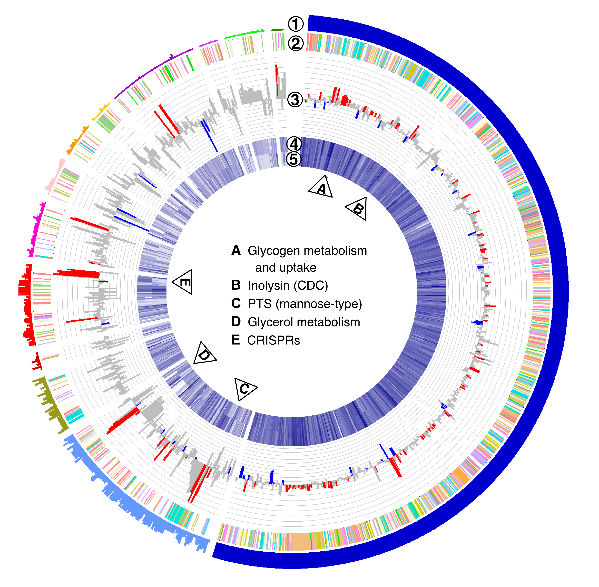
Response of L. iners
Core transcriptome generally expressed abundantly
Large differences in strain specific genes
Evidence of differential expression of sugar acquisition and metabolism, CAS proteins and inolysin
Housekeeping genes had generally small variation
*Macklaim et al. (2013) Microbiome
Notes:
I talked about L. iners being persistent in healthy and BV so one of the first questions I had was how it’s gene expression differed in these different conditions
This is a circular representation of the L. iners’ pan-transcriptome – all the UNIQUELY expressed genes from different strains
Pan-genome: Full set of UNIQUE genes for all strains species (there is a core, disposable (2+ strains), and unique gene set)
Explain rings first
1. Conservation (only showing core first) i.e. number of genomes the gene is detected (of 12 total)
2.COG functions – Gives us a broad pictures of the functional categories
3. This is the differential expression. Height of the bar is fold change, above the line is up BV and below is up in N. Red or blue indicates the difference is significant
4 (BV) and 5(N) heatmap representation of the expression – darker blue is more highly expressed
What is the core doing
Functions mostly related to cell maintenance
Generally highly expressed
Low fold change
Interesting: two loci (marked A) for glycogen metabolism
A (human) cytotoxic lysin is 6-fold up in BV
What are some strain-specific adaptations
Functions less-well annotated
Big swings in gene expression – some could be due to differential strain presence
Example: transport of mucin products (6/12 strains) and these CRISPRs which have a role in bacteriophage defense (6/12 strains)

Slide 28
Abundance does not always predict functional contribution
Abundant by 16S but transcriptionally rare
Notes:
These are the same data I just showed you, but represented in taxonomic abundance barplots at both using 16S (top) and by mRNA (bottom)
By hierarchical clustering of the transcriptome, there are four main subgroups: two associated with health on the left in blue, and two associated with BV on the right
What I want to show you is the difference between the taxonomic contributions at the 16S level (the top plot) compared to the taxonomic contributions from the mRNA level (bottom plot)
This is summarized per taxon in the boxplots on the left
In some cases, like the blue L. crispatus organism, it’s punching above it’s weight and contributing more transcriptionally than you’d expect
And in other cases, like the white Atopobium organism there is hardly any transcriptional activity compared to the 16S abundance

Slide 29
The effect of functional grouping
Higher variance explained in PC1 (41% vs. 52%)
Compositionally different (species-specific genes, but functional redundancy per condition)
Notes:
I mentioned before that we also grouped refseq clusters into functional groups by comparison to the SEED subsystem database
On the left is the biplot I just showed you at the refseq, or taxonomic level, and on the right is plotting the same data that has now been binned into subsystem4 groups
The samples fall into the same four inferred subgroups that were shown by hierarchical clustering on the previous plot, and these, again, correspond to different subtypes of the disease condition
The major split on component one is still between the healthy and dysbiotic BV state, but in this case there is better separation - larger PC1 (41% vs 52%)
This suggests two key conclusions
1. That there is a redundancy in functions despite differences in taxonomic composition. In other words, different species can contribute to the same functions
2. That these conserved biochemical functions are the major unit of interest contributing to the condition (rather than individual genes)
This is starting to think of the system as a meta-organism instead of individuals in a community

Slide 30
SEED subsystem differential expression
*Macklaim et al. (2013) Microbiome
Notes:
This is an overview of some of the differential functions between healthy and BV
Each dot on this plot is a specific function - they are plotted by broader functional groups (labeled on the left)
The functions are plotted by their fold change in expression – BV on the right, and non-BV on the left.
If the dots are COLORed red or blue it means they are significantly differential
(((click))) Looking at a few examples: functions related to glycogen breakdown are generally up in BV
(((click))) Pick out the significant functions and represent the fraction of the reads belonging to each organism. So each bar is a sample, and each par is one function(dot) from the plot
Mostly Gardnerella (red) and Prevotella biva (purple) EXPRESSING these functions
Sometimes it’s different organism in a particular sample, but the outcome is this function is CONSERVED in BV
(((click))
Butyrate: More apparent here. Might have a scenario where products are being passed between organisms to perform one metabolic process

Slide 31
SEED subsystem differential expression
*Macklaim et al. (2013) Microbiome
Notes:
This is an overview of some of the differential functions between healthy and BV
Each dot on this plot is a specific function - they are plotted by broader functional groups (labeled on the left)
The functions are plotted by their fold change in expression – BV on the right, and non-BV on the left.
If the dots are COLORed red or blue it means they are significantly differential
(((click))) Looking at a few examples: functions related to glycogen breakdown are generally up in BV
(((click))) Pick out the significant functions and represent the fraction of the reads belonging to each organism. So each bar is a sample, and each par is one function(dot) from the plot
Mostly Gardnerella (red) and Prevotella biva (purple) EXPRESSING these functions
Sometimes it’s different organism in a particular sample, but the outcome is this function is CONSERVED in BV
(((click))
Butyrate: More apparent here. Might have a scenario where products are being passed between organisms to perform one metabolic process

Slide 32
Reconstruct metabolic pathways – Glycerol metabolism
Prevotella amnii
L. iners
L. iners
L. crispatus
*Macklaim et al. (2013) Microbiome
Notes:
Once we know WHO is doing WHAT, we can interconnect the pathways

Slide 33
Associations in health and BV
Phi*: correlations in compositional space
Association between features
Coordinate position shows association with samples
H2
BV2
H cluster 1
Sugar metabolism, …
H cluster 2
DNA rep and repair, …
BV cluster 1
Polyamines, oxorecuctases, ...
H1
BV1
*Lovell et al. (2015) PLoS
*G. Gloor CoDa-seq
Notes:
We had previously already looked at the major differences between the conditions, so we did an unsupervised correlation analysis using Phi – which works within the compositional framework
I'm showing the same subsys4 function biplot, just with some filtering
This time the functions are colored by the network they associate with as predicted by Phi correlations
On the healthy side of the plot on the left there are two major clusters in blue containing functions we know to be associated with the condition
And on the BV side on the right there is a large cluster group in red with functions for poly-amines and other expected associations in BV

Slide 34
Differential transcript abundance in BV subgroups
Using ALDEx2 (ANOVA-Like Differential Expression)
Effect size:
btwn condition diff
within-condition var
Notes:
One outstanding question I had was once we’d identified two BV subgroups, was to find out which specific functions were different between them
For this I used ALDEx which uses principles of Compositional Data Analysis and effect sizes to infer differences between groups
The effect size is a a ratio of the between-condition difference over the within condition variance
Each dot is an individual function plotted by a higher level group. On the x-axis is the Effect size as a way to visualize the magnitude of the change
Colored dots (red or blue for each condition) are significantly different
Some differences are metabolic (which we expectedly see in the metabolome) and some are structural (which we would not see in the metabolize analysis)

Slide 35
Motility
Motility associated genes are driving the difference between the BV1 and BV2 groups
Structural genes, not enzymes
Only found after assembly
H2
BV2
H1
BV1
Notes:
We had previously already looked at the major differences between the conditions, so we did an unsupervised correlation analysis using Phi – which works within the compositional framework
I'm showing the same subsys4 function biplot, just with some filtering
This time the functions are colored by the network they associate with as predicted by Phi correlations
On the healthy side of the plot on the left there are two major clusters in blue containing functions we know to be associated with the condition
And on the BV side on the right there is a large cluster group in red with functions for poly-amines and other expected associations in BV

Slide 36
Metabolite associations
*Amy McMillan
GC-MS
NMR
H2
BV2
H2
BV2
H1
H1
BV1
BV1
Health: amino acids
BV: Amines and organic or short chain fatty acids
Notes:
I’m only going to show you briefly some associations with metabolites which was work done by a PhD student, Amy McMillan
She used two untargeted metabolomic methods for this study
One, using GC-MS, and the second using NMR
The biplot again in the same subsystem 4 functional biplot with healthy samples on the left and BV on the right
This time, overlaid on the plot are the associated metabolites
key: These correspond very well to the differential functions. For example. There is a large abundance of amines and organic or short chain fatty acids associated with BV on the right
I’ll mention we’ve had some success (manually) connecting metabolites to individual pathways in the transcriptome data but this largely remains an open problem
-------------------------------------------
Some success: Gardnerella Vaginalis GHB production (A. McMillan)
Open problem: correlating transcript and metabolite abundances

Slide 37
Metabolites correlate with diversity
Two cohorts of women from Rwanda (P=67, NP=64)
Collected for metabolome and 16S tag sequence
PLS plot shows metabolite samples partition by microbiome diversity
*MacMillan et al. (2015) Sci. Rep

Slide 38
Metabolites are same in both cohorts
PLS loadings plot shows metabolites partition by microbiome diversity
Pregnant and non-pregnant women have very similar metabolite profiles
*MacMillan et al. (2015) Sci. Rep

Slide 39
Correlates with diversity and taxa present
Combined dataset
Which metabolites most associated with Health, or BV
Dogma:
Succinate (BV) / Lactate (H)
Reality?
*MacMillan et al. (2015) Sci. Rep

Slide 40
Best biomarkers
*MacMillan et al. (2015) Sci. Rep

Slide 41
Validation in blinded cohort
Third pregnant cohort from Tanzania (n=45)
*MacMillan et al. (2015) Sci. Rep

Slide 42
So who makes what?
*MacMillan et al. (2015) Sci. Rep

Slide 43
Testing the correlation
*MacMillan et al. (2015) Sci. Rep

Slide 44
Overall summary
Sequencing data are inherently compositional and a CoDa framework and provides a robust analysis of variance (Part 2)
Some functions are conserved regardless of the community members
Ecosystem is more important than any organism
Community members can cooperate
Using two high-resolution methods (metabolome, and metaRNAseq) provides a more holistic view of a complex system
Agreements (H v BV: amines, succinate), different resolution
Correspondence between DNA, RNA, small molecules
Relationship status: it’s complicated but some successes
Combining different ‘omics data (e.g. mRNA and metabolites) remains an open problem
Notes:
----------------------------------
Inferring from 16S would be misleading: organism abundance and transcript abundance not necessarily related….and out to small molecules detected
Still need virome and proteome, etc.
Describing the functional diversity through transcriptomics gives insight to the response of bacteria to changes in environment and potential effects on host
A better “omics” understanding will allow us to target and modulate the microbiome in predictable ways

Slide 45
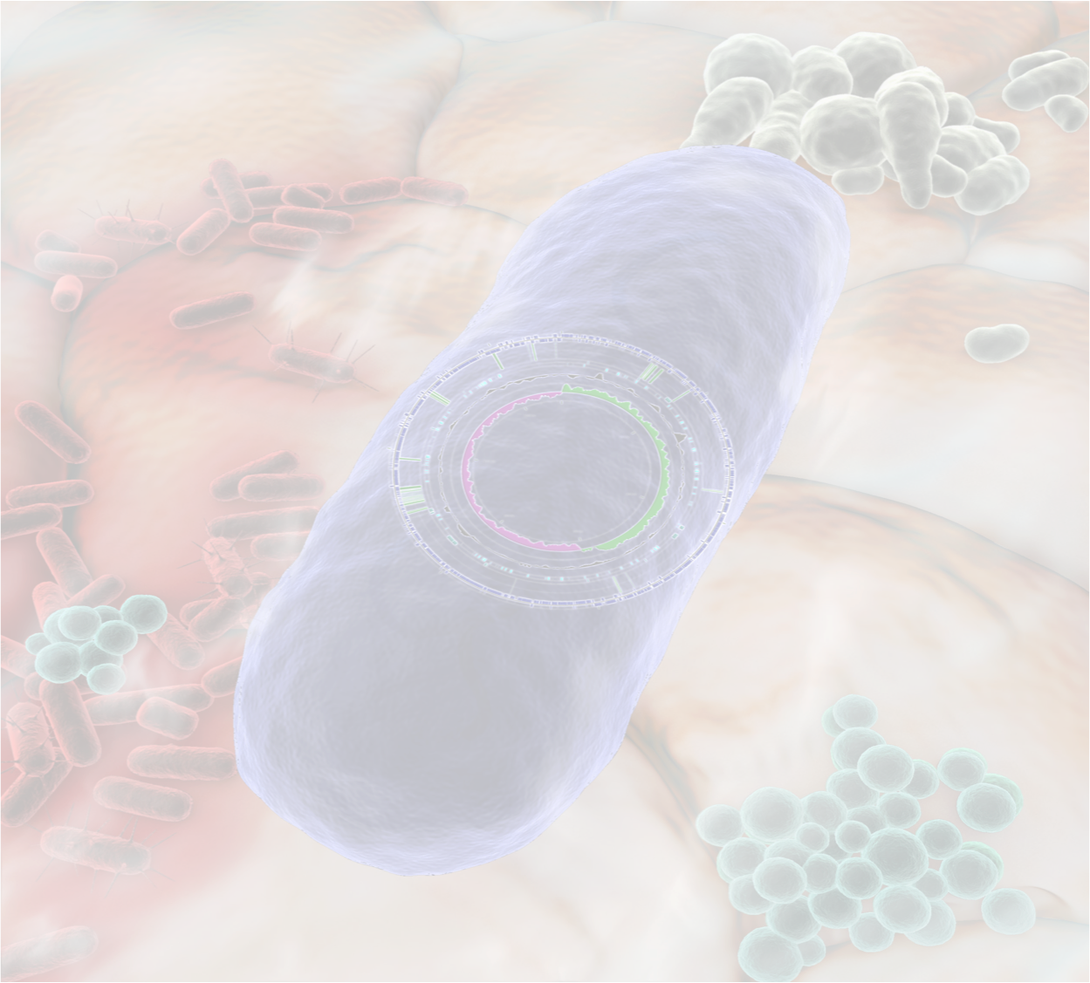




Acknowledgements
Jean Macklaim
Victoria Family Medical Centre
Dr. Jo-Anne Hammond
Holly Inges
Jerry Wu
Ruth Grace Wong
Agriculture Canada
Mark Sumurah
U. Guelph/Queens U.
Emma Allen-Vercoe
Elaine Petrof
Gregor Reid
Amy McMillan
mmacklai.github.io
ggloor.github.io
Notes:
With that, I’ll thank the people on this slide and thank you for listening

Slide 46
Associations in health and BV
Same results in a different database
H2
BV2
H1
BV1
Notes:
Same results with another database: KEGG (show this?)

